Slide 1
ML (PG) 2021 Project
Fake News Disambiguation: Why Is It Fake?
Members:-
Karish Grover
2019471
karish19471@iiitd.ac.in
Nirali Arora
Phd21002
niralis@iiitd.ac.in
Aisha Aijaz
PhD21011
aishaa@iiitd.ac.in
Group 45

Slide 2
Attention-enhanced Multi-channel Recurrent Convolutional Network (AMRCN)
This project considers the fake news detection problem under a more realistic scenario on social media.
Given the short text tweet content, we aim to classify this tweet as fake or real, i.e., binary classification.
Further, we aim to explain why this tweet is fake/actual by highlighting tokens/phrases from the tweet content that contribute relatively more to the final prediction

Slide 3
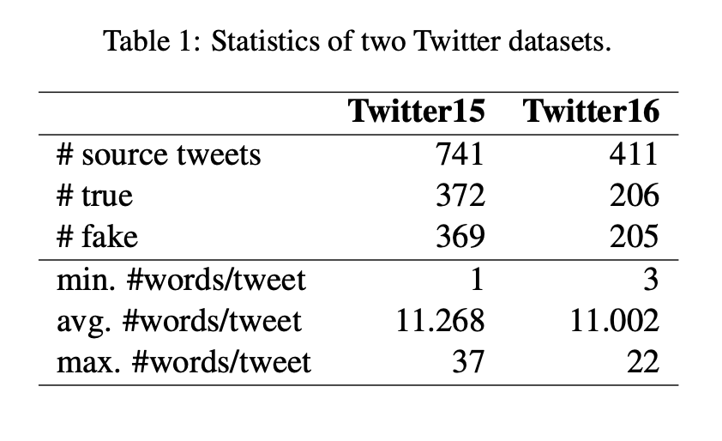
Dataset Collection and Preprocessing
We utilize two well-known datasets compiled by (Ma et al., 2017), Twitter15 and Twitter16, for our work. These datasets contain source tweets and their corresponding sequences of retweet users.
These datasets are balanced towards the classes and consist of short length tweets. We remove the stop words from the tweets, replace all URLs with the token URL, and stem the tweets in the dataset for proceeding with the experiments.

Slide 4
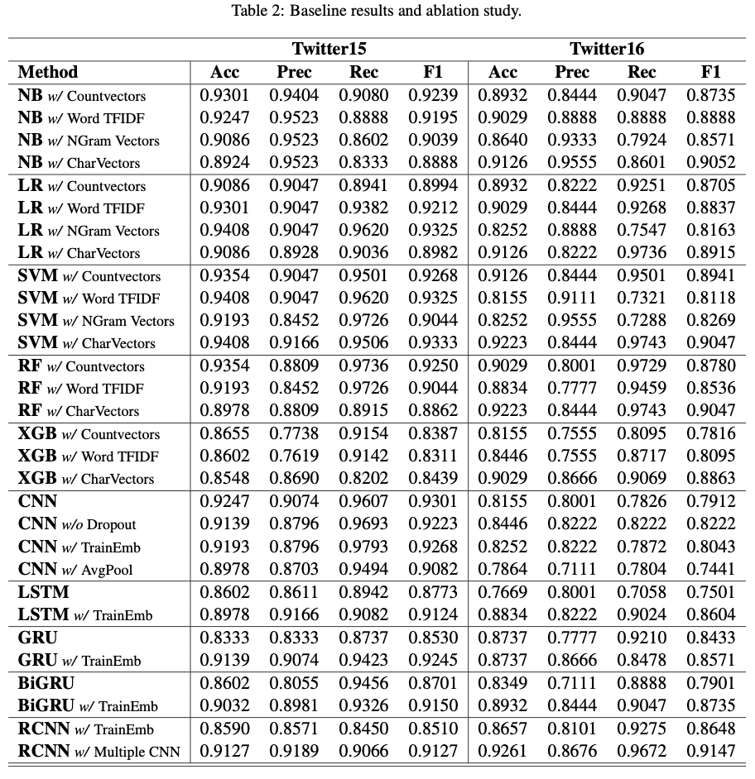
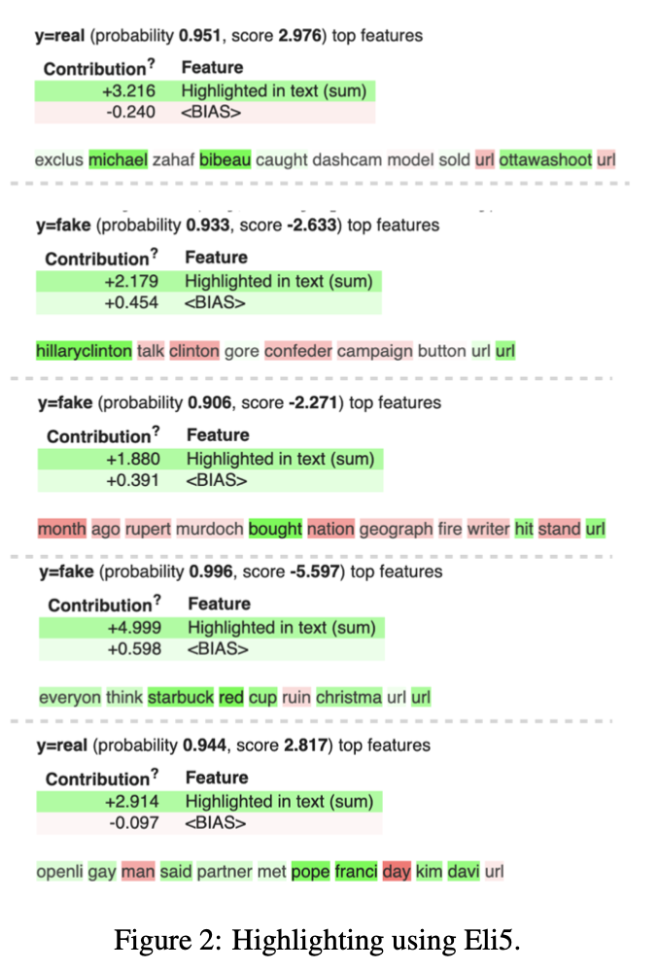
Baselines and Experimentation

Slide 5
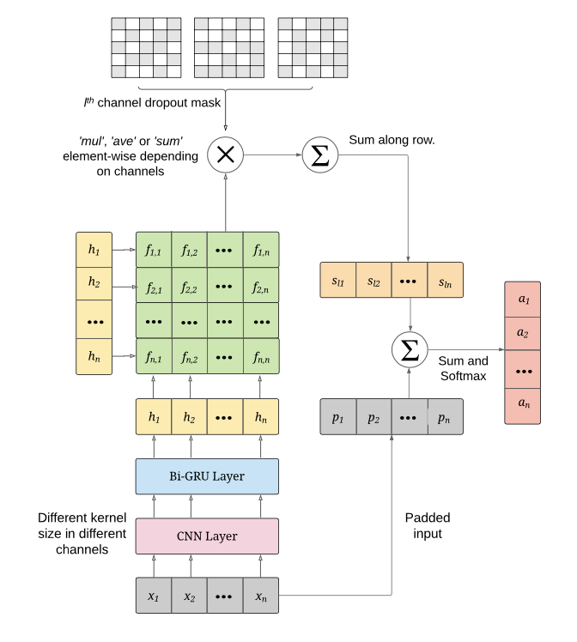
Model Architecture
The model architecture can be divided into four broad parts:
(1) CNN-based Representation
(2) Attention enhanced Word-level Encoder
(3) Multiple Channels
(4) Explainability of the Prediction.

Slide 6
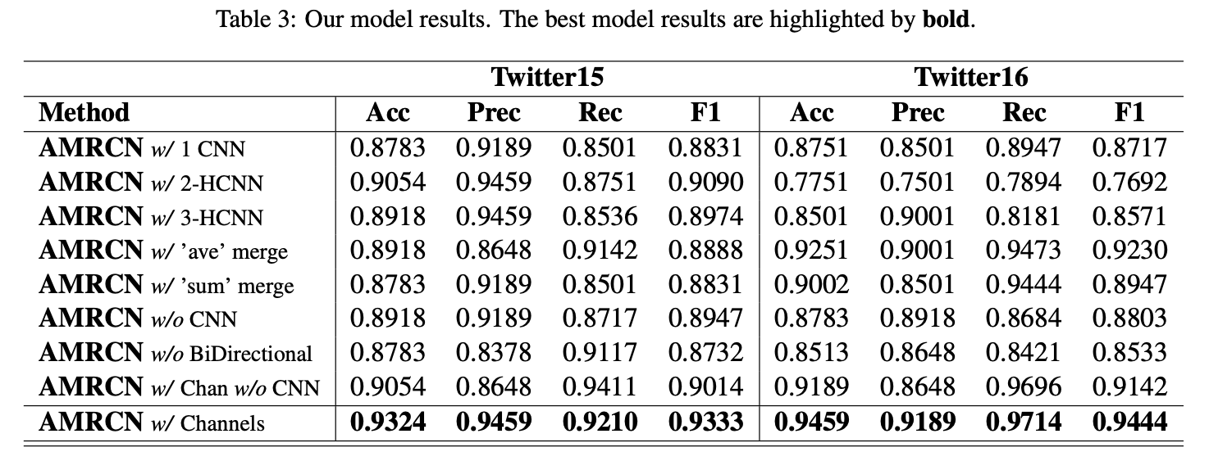
Final Model Results

Slide 7
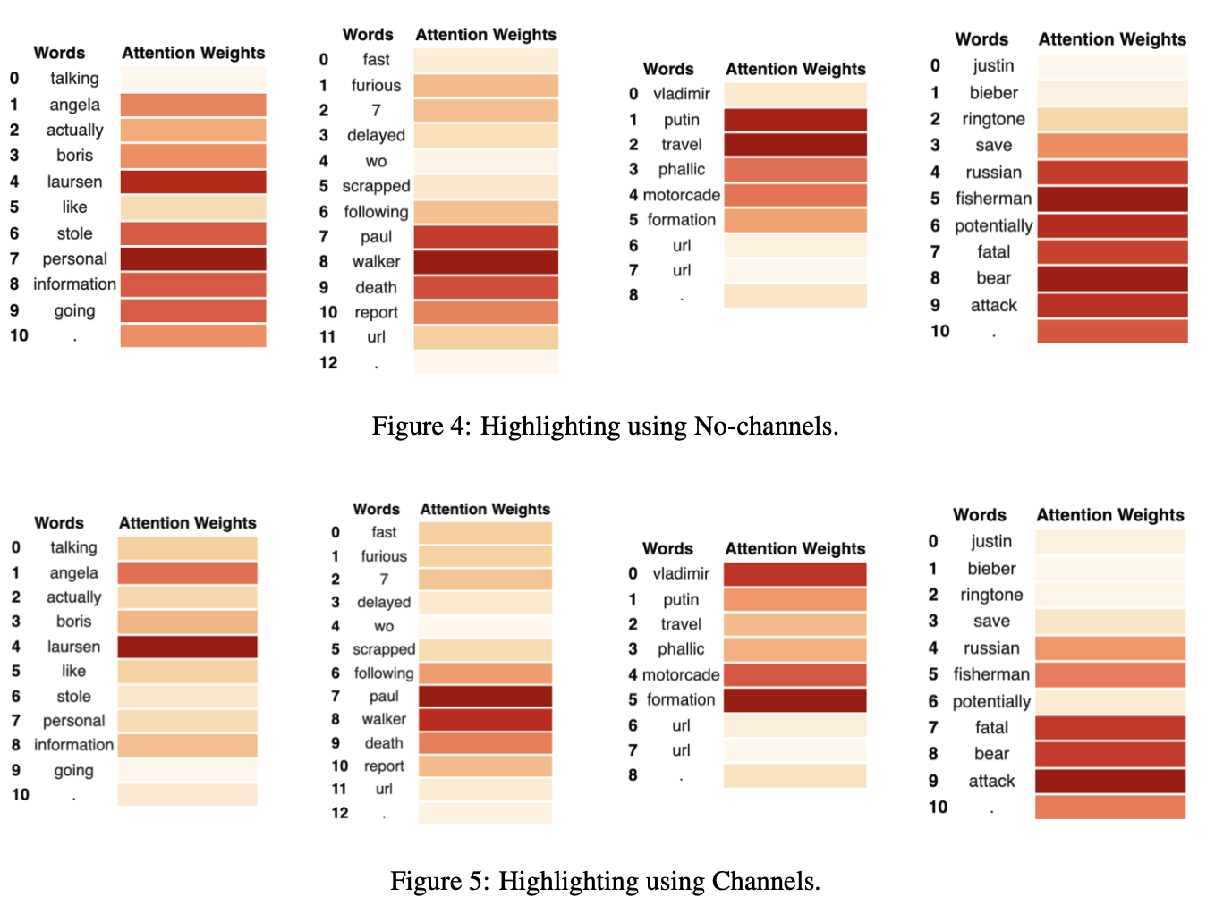
Explainability
As it can be seen from the example visualization above, in the sentence ”fast and furious 7 scrapped following paul walker’s death report”, the words ”paul”, ”walker”, and ”death” are the most significant towards the final prediction that it is a True piece of information. This use of attention weights to give explanations is quite reasonable.

Slide 8
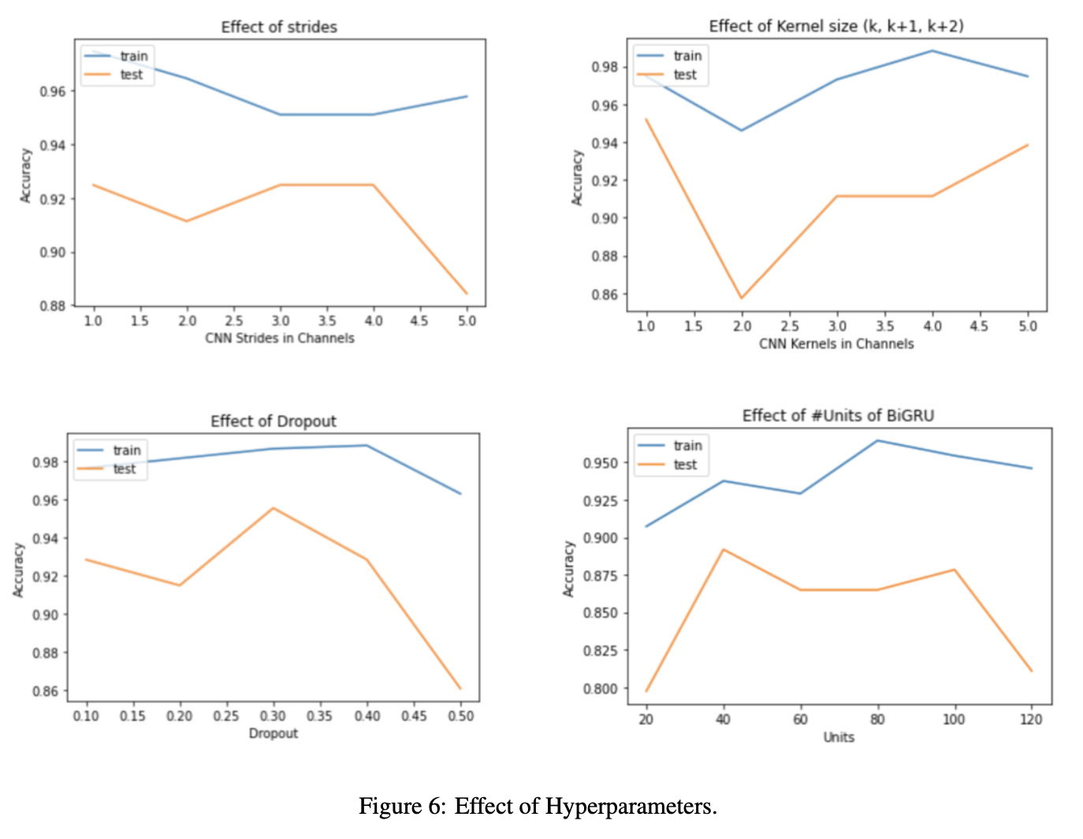
Effect of Hyperparameters

Slide 9
Contributions
Karish Grover:- Baselines implementation, Dataset extraction, Report writing compilation, Model Implementation
Nirali Arora and Aisha Aijaz:- Model research and analysis, Report Writing, PPT, Blog

